Slide 1


Slide 2
Reminder cycle

Slide 3
The basic remainder formula is:
Dividend = Divisor* Quotient + Remainder
If remainder = 0, then it the number is perfectly divisible by divisor and divisor is a factor of the number e.g. when 8 divides 40, the remainder is 0, it can be said that 8 is a factor of 40.
Formulas Based Concepts for Remainder:
(a^{n} + b^{n}) is divisible by (a + b), when n is odd.
(a^{n} - b^{n}) is divisible by (a + b), when n is even.
(a^{n} - b^{n}) is always divisible by (a - b), for every n.

Slide 4
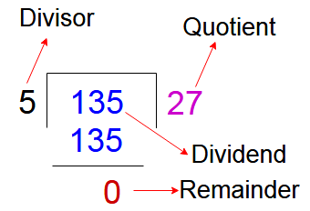
Before going to concepts of remainder theorem of numbers, it is better to understand the the concepts of Divisor, Dividend, Quotient and Remainder

Slide 5
Important Points
The sum of consecutive five whole numbers is always divisible by 5.
The square of any odd number when divided by 8 will leave 1 as the remainder
The unit digit of the product of any nine consecutive numbers is always zero.
For any natural number n, 10^{n}-7 is divisible by 3.
Any three-digit number having all the digits same will always be divisible by 37.

Slide 6
The Remainder Cycle
If “25 ÷ 7 is 3 with 4 left over, so we say it is 3 remainder 4.”
When dividing by 7, 8 has remainder 1, 9 has remainder 2, 10 has remainder 3, 11 has remainder 4, 12 has remainder 5, 13 has remainder 6, 14 has remainder 0, 15 has remainder 1, 16 has remainder 2, 17 has remainder 3… etc. etc. etc.,
When dividing integers by integer n, there are n possible remainders, 0 through (n-1), and these remainders cycle in an infinite loop.

Slide 7
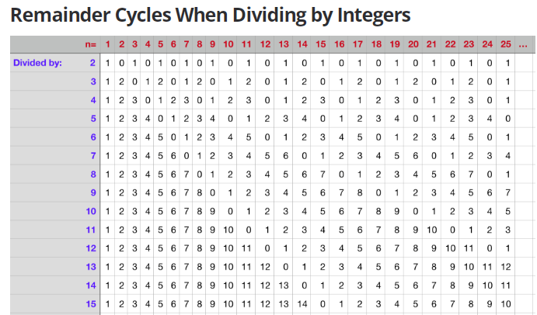

Slide 8
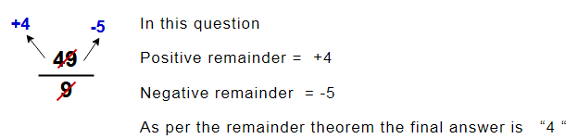
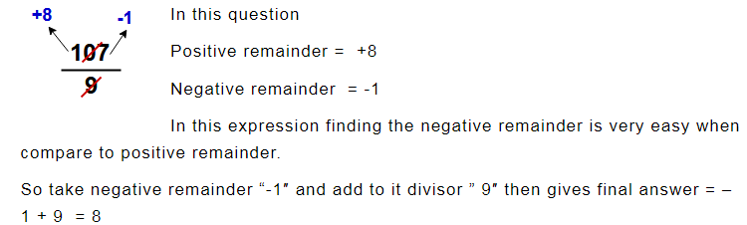
Remainder Theorem Rule – 1 (Fundamental)
Remainder - expressed as positive remainders and negative remainders. Technically both positive and negative remainders are correct.
But remainders by definition are always non-negative. So final answer to be expressed in positive value only.

Slide 9


Remainder Theorem Rule – 2 (For long expressions)
The remainder of the expression will be the same as
the remainder of the expression
Where
A_{R} is the remainder when “A” is divided by ” N”,
B_{R} is the remainder when “B” is divided by ” N”,
C_{R} is the remainder when “C” is divided by ” N”,
D_{R} is the remainder when “D” is divided by ” N”,

Slide 10
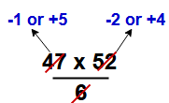
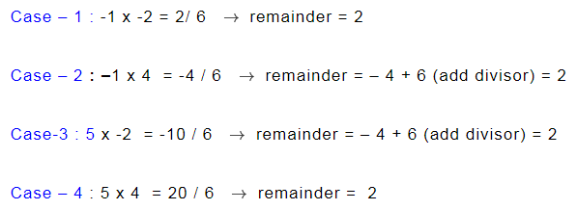
Find the remainder when 47 x 52 is divided by 6
Here remainder for 7/6 is -1 or 5 and 52/6 is -2 or 4

Slide 11



Remainder Theorem Rule – 4 (remainder of a number with power )
There are two rules which are effect in order to deal with large powers
Case – 1 : If we can express the expression in the form
the remainder will become 1 directly.
In this case , there is no matter how large the value of the power “n” is, the remainder is 1.
Case – 2 : If we can express the expression in the form
the remainder will become ( – 1 )^{n} directly.
In this case , if n is even number then remainder will be 1 and if n is odd number then remainder will be (q-1)

Slide 12
Question 1
Find the remainder when (321)⁵⁶⁸⁷ is divided by 8
1
2
3
D) 4
Notes:
Answer: A
olution: 321 can be expressed as [(8×40) + 1] so
remainder of the above question is (1)⁵⁶⁸⁷ = 1

Slide 13
Question 2
Find the remainder when (146)⁵⁶ is divided by 7
1
3
5
D) 7
Notes:
Answer: A
Solution: 146 can be expressed as [(7×21) – 1] so
Remainder of the above question is (- 1)⁵⁶ = 1
(-1)^EVEN=+1
(-1)^ODD=-1

Slide 14
Question 3
Find the remainder when (269)⁵⁷⁵⁸⁷ is divided by 6
4
5
6
D) 8
Notes:
Answer: B
Solution: 269 can be expressed as [( 6x 45) – 1] so
Remainder of the above question is (- 1)⁵⁷⁵⁸⁷ = – 1 = -1 + 6 = 5

Slide 15
Question 4
Find the remainder when 73 x 75 x 78 x 194 x 57 is divided by 25
1
3
0
D) 7
Notes:
Answer: C
Solution:
If denominator is perfectly divisible by any one number of given numerator expression values then remainder of the whole expression is Zero.

Slide 16
Question 5
Find the remainder when 84 + 98+ 197 + 240 + 140 is divided by 32
13
16
23
D) 27
Notes:
Answer: C
759/32
So reminder of the above expression is 23

Slide 17
Question 6
What is the remainder of 1421 * 1423 * 1425 when divided by 12 ?
1
2
3
D) 4
Notes:
Answer: C
1421, 1423 and 1425 gives 5, 7 and 9 as remainders respectively when divided by 12.
Remainder [ (1421 * 1423 * 1425 ) / 12 ] = Remainder [ (5 * 7 * 9) ] / 12, gives a remainder of 3.

Slide 18
Question 7
Find the remainder when 1! + 2! + 3! + . . . . .. . .. 99! + 100! is divided by the product of first 7 natural numbers
870
873
875
D) 876
Notes:
Answer: B
From 7! the remainder will be zero. Why ? because 7! is nothing but product of first 7 natural numbers and all factorial after that will have 7! as one of the factor. so we are concerned only factorials till 7!, i.e, 1! + 2! + 3! + 4! + 5! + 6!
1! + 2! + 3! + 4! + 5! + 6! = 873 and as 7! > 873 our remainder will be 873

Slide 19
Question 8
What is the remainder when 64⁹⁹⁹ is divided by 7?
1
2
3
D) 4
Notes:
Answer: A
Remainder [64⁹⁹⁹ / 7 ] = Remainder[ 64 * 64 * …. 64 (999 times) / 7 ]
Remainder[64/7] = 1, hence Remainder [64⁹⁹⁹ / 7 ] = Remainder [ 1 ⁹⁹⁹ / 7 ] = 1

Slide 20
Question 9
What is the remainder when 444^{444 ^ 444} is divided by 7 ?
2
4
1
D) 5
Notes:
Answer: C
Remainder[444/7] = 3
Remainder[ 444 ^{444 ^ 444} / 7 ] = Remainder [ 3 ^{444 ^ 444} / 7 ]
= Remainder [ ( 3² ) ^{222 ^ 444} / 7 ] = Remainder [ 2^{222 ^ 444} / 7 ] ( As Remainder [ 3² / 7 ] = 2 )
= Remainder [ ( 2³ ) ^{74 ^ 444} / 7] = Remainder [ 1 ^{74 ^ 444} / 7 ] = 1 ( As Remainder [ 2³ / 7 ] = 1 )

Slide 21
Question 10
What is the remainder when 15²³ + 23²³ is divided by 19 ?
0
1
2
D) 3
Notes:
Answer: A
15²³ + 23²³ is divisible by 15 + 23 = 38 ( as 23 is odd).
So Rem[(15²³ + 23²³)/19] = 0

Slide 22
Question 11
A number when divided by 18 leaves a remainder 7. The same number when divided by 12 leaves a remainder n. How many values can n take?
0
1
2
D) 3
Notes:
Ans; c)
Number can be 7, 25, 43, 61, 79. Remainders when divided by 12 are 7 and 1. n can take exactly 2 values

Slide 23
Question 12
N leaves a remainder of 4 when divided by 33, what are the possible remainders when N is divided by 55?
5
2
1
D) 4
Notes:
Ans; a)
The LCM of 33 and 55 is 165. This is the starting point. If a number leaves a remainder of 4 when divided by 33, it can leave remainders 4, 37, 70, 103, and 136. Or the number can be of the form 165n +4, or 165n + 37 or 165n + 70, 103 or 136 When divided by 55, the possible remainders are 4, 37, 15, 48 and 26

Slide 24
Question 13
If a number is divided by 357 the remainder is 5, what will be the remainder if the number is divided by 17?
5
2
1
D) 4
Notes:
Explanation:
Let
be the given numbe
If this number is divided by 17 remainder is 5 as 357k is exactly divided by 17.
N=357k+5/17
=17*5k+5/17
ans=5

Slide 25
Question 14
Find the remainder when 97 ^{97 ^ 97} is divided by 11
1
2
3
D) 4
Notes:
Answer: D
Remainder [97/11] = 9
So, Remainder [97^{97^97}/11] = Remainder [9 ^{97^97}/11]
From Euler’s theorem, Remainder [9¹⁰/11] = 1
97 and 10 are again co primes. So φ(10) = 10 (1-1/2) (1-1/5) = 4
Remainder [97⁴/11] = 1
97 = 4n + 1, So Remainder [97⁹⁷/11] = Remainder [97/10] = 7
Means 97⁹⁷ can be written as 10n + 7
Now our original question,
Remainder [9^{97^97}/11] = Remainder [9^{10n+7}/11] = Remainder [9⁷/11] = 4

Slide 26
Question 15
The sum of the digits of a number N is 23. The remainder when N is divided by 11 is 7. What is the remainder when N is divided by 33?
7
29
16
D) 13
Notes:
Ans ; b)
Sum of digits = 23 Remainder when N is divided by 9 N/9 = 5 {Remainder on division by 9 for any number is equal to the remainder of dividing the sum of the digits of the number by 9} => Remainder of N/3 = 2 {A number of the form 9k + 5 divided by 3 leaves a remainder 2} N = 11k + 7 N = 3m + 2 11k + 7 => Possible numbers are 7, 18, 29, 40, 51 3m + 2 => Possible numbers are 2, 5, 8, 11, 14, 17, 20, 23, 26, 29 The number that is of the form 11k + 7 and 3m + 2 should be of the form 33b + 29. How did we arrive at this result? The first natural number that satisfies both properties is 29. Now, starting with 29, every 11th number is of the form 11k + 7, and every 3rd number is of the form 3m + 2. So, starting from 29, every 33rd number should be on both lists (33 is the LCM of 11 and 3). Or, any number of the form 33b + 29 will be both of the form 11K + 7 and 3m + 2, where b, k, m are natural numbers. The remainder when the said number is divided by 33 is 29.

Slide 27
Question 16
N² leaves a remainder of 1 when divided by 24. What are the possible remainders we can get if we divide N by 12?
1, 5, 7 and 11
1, 5, 7 and 13
2, 5, 7 and 17
D) 2, 5, 11 and 13
Notes:
Answer: A
N is an odd number. So, the remainder when we divide N by 24 has to be odd. If the remainder when we divide N by 24= 1, then N2 also has a remainder of 1. we can also see that if the remainder when we divide N by 24 is -1, then N2 a remainder of 1. When remainder when we divide N by 24 is ±3, then N2 has a remainder of 9. When remainder when we divide N by 24 is ±5, then N2 has a remainder of 1. When remainder when we divide N by 24 is ±7, then N2 has a remainder of 1. When remainder when we divide N by 24 is ±9, then N2 has a remainder of 9. When remainder when we divide N by 24 is ±11, then N2 has a remainder of 1. So, the remainder when we divide N by 24 could be ±1, ±5, ±7 or ±11. Or, the possible remainders when we divide N by 24 are 1, 5,7, 11, 13. 17, 19,23. Or, the possible remainders when we divide N by 12 are 1, 5,7, 11.

Slide 28
THANK YOU

